Slide 1
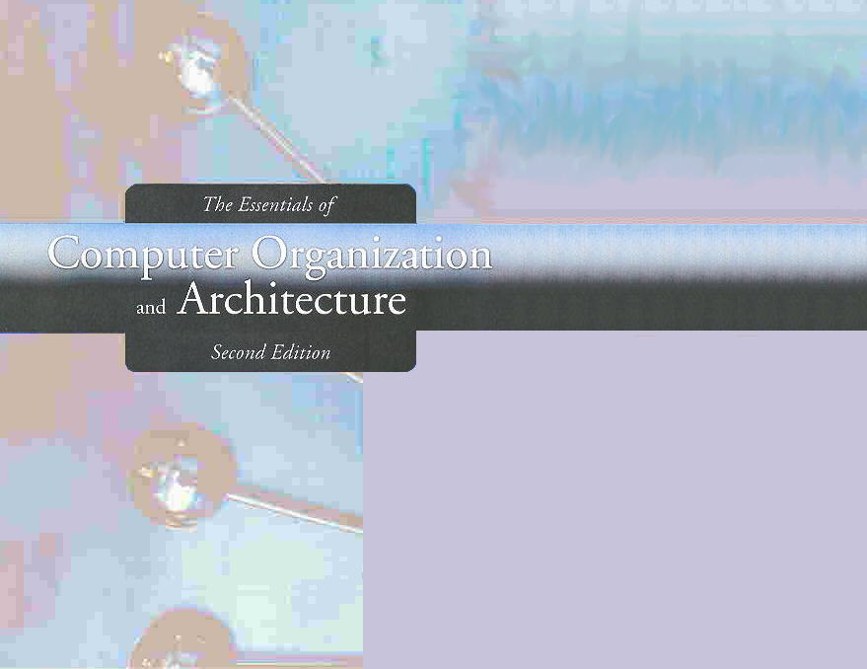
Chapter 2
Data Representation in Computer Systems

Slide 2

2.1 Introduction
A bit is the most basic unit of information in a computer.
  It is a state of “on” or “off” in a digital circuit.
  Sometimes they represent high or low voltage
  A byte is a group of eight bits.. It is the smallest possible addressable unit of computer storage.

Slide 3
2.1 Introduction
A word is a contiguous group of bytes.
  Words can be any number of bits or bytes.
  Word sizes of 16, 32, or 64 bits are most common.

Slide 4
2.2 Positional Numbering Systems
  The binary system is also called the base-2 system. (101100.011)
  Our decimal system is the base-10 system. It uses powers of 10 for each position in a number. (975.3)
  Any integer quantity can be represented exactly using any base (or radix). (3077 octal or 2BAD hex)

Slide 5
2.2 Positional Numbering Systems
The decimal number 947 in powers of 10 is:
The decimal number 5836.47 in powers of 10 is:
  9 × 10 ² + 4 × 10 ¹ + 7 × 10 ⁰
  5 × 10 ³ + 8 × 10 ² + 3 × 10 ¹ + 6 × 10 ⁰
  + 4 × 10 ⁻¹ + 7 × 10 ⁻²

Slide 6
2.2 Positional Numbering Systems
The binary number 11001 in powers of 2 is:
When the radix of a number is something other than 10, the base is denoted by a subscript.
  Sometimes, the subscript 10 is added for emphasis:
  11001₂ = 25₁₀
  1 × 2 ⁴ + 1 × 2 ³ + 0 × 2 ² + 0 × 2 ¹ + 1 × 2 ⁰
  = 16 + 8 + 0 + 0 + 1 = 25

Slide 7
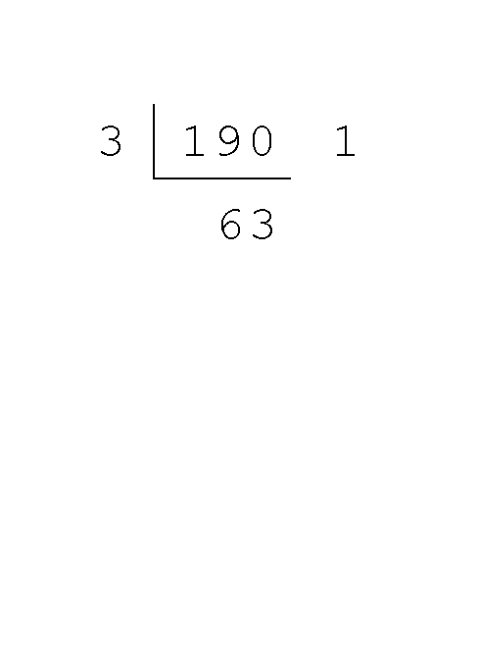
2.3 Decimal to Binary Conversions
Converting 190 to base 3...
  First we take the number that we wish to convert and divide it by the radix in which we want to express our result.
  In this case, 3 divides 190 63 times, with a remainder of 1.
  Record the quotient and the remainder.

Slide 8
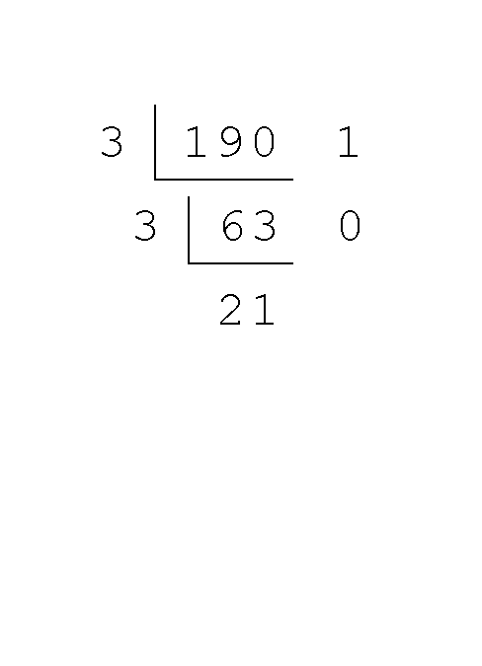
2.3 Decimal to Binary Conversions
Converting 190 to base 3...
  63 is evenly divisible by 3.
  Our remainder is zero, and the quotient is 21.

Slide 9
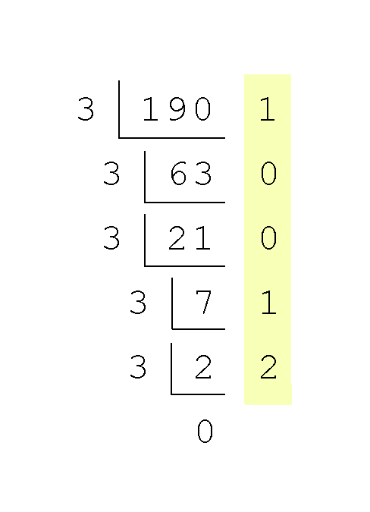
2.3 Decimal to Binary Conversions
Converting 190 to base 3...
  Continue in this way until the quotient is zero.
  In the final calculation, we note that 3 divides 2 zero times with a remainder of 2.
  Our result, reading from bottom to top is:
  190₁₀ = 21001₃

Slide 10
2.3 Decimal to Binary Conversions
Fractional values can be approximated in all base systems.
Unlike integer values, fractions do not necessarily have exact representations under all radices.
The quantity 1/2 is exactly representable in the binary and decimal systems, but is not in the ternary (base 3) numbering system.

Slide 11
2.3 Decimal to Binary Conversions
Fractional decimal values have nonzero digits to the right of the decimal point.
Fractional values of other radix systems have nonzero digits to the right of the radix point.
Numerals to the right of a radix point represent negative powers of the radix:
  0.47₁₀ = 4 × 10 ⁻¹ + 7 × 10 ⁻²
  0.11₂ = 1 × 2 ⁻¹ + 1 × 2 ⁻²
  = 0.5 + 0.25 = 0.75

Slide 12
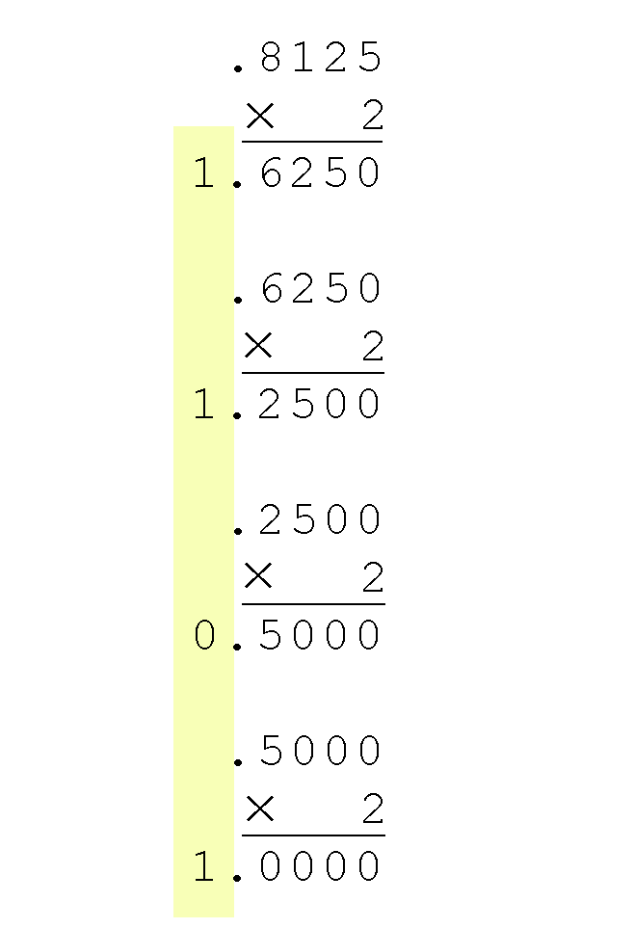
2.3 Decimal to Binary Conversions
Converting 0.8125 to binary . . .
  You are finished when the product is zero, or until you have reached the desired number of binary places.
  Our result, reading from top to bottom is:
  0.8125₁₀ = 0.1101₂
  This method also works with any base. Just use the target radix as the multiplier.

Slide 13
2.3 Decimal to Binary Conversions
It is difficult to read long strings of binary numbers-- and even a modestly-sized decimal number becomes a very long binary number.
  For example: 11010100011011₂ = 13595₁₀
For compactness and ease of reading, binary values are usually expressed using the hexadecimal, or base-16, numbering system.

Slide 14
2.3 Decimal to Binary Conversions
The hexadecimal numbering system uses the numerals 0 through 9 and the letters A through F.
  The decimal number 12 is C₁₆.
  The decimal number 26 is 1A₁₆.
It is easy to convert between base 16 and base 2, because 16 = 2⁴. all we need to do is group the binary digits into groups of four.

Slide 15
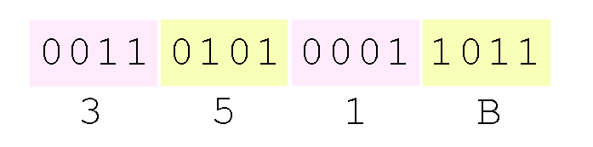
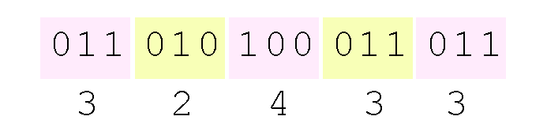
2.3 Decimal to Binary Conversions
Using groups of hextets, the binary number 11010100011011₂ (= 13595₁₀) in hexadecimal is:
Octal (base 8) values are derived from binary by using groups of three bits (8 = 2³):
Octal was very useful when computers used six-bit words.

Slide 16
2.4 Signed Integer Representation
The conversions we have so far presented have involved only positive numbers.
To represent negative values, computer systems allocate the high-order bit to indicate the sign of a value.
  The high-order bit is the leftmost bit in a byte. It is also called the most significant bit.
The remaining bits contain the value of the number.

Slide 17
2.4 Signed Integer Representation
There are three ways in which signed binary numbers may be expressed:
  Signed magnitude,
  One’s complement and
  Two’s complement.
In an 8-bit word, signed magnitude representation places the absolute value of the number in the 7 bits to the right of the sign bit.

Slide 18
2.4 Signed Integer Representation
For example, in 8-bit signed magnitude, positive 3 is: 00000011
Negative 3 is: 10000011
Computers perform arithmetic operations on signed magnitude numbers in much the same way as humans carry out pencil and paper arithmetic.
  Humans often ignore the signs of the operands while performing a calculation, applying the appropriate sign after the calculation is complete.

Slide 19
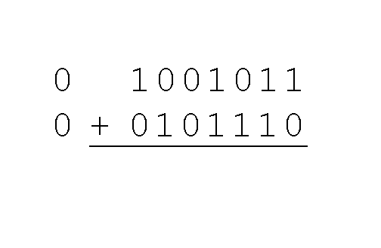
2.4 Signed Integer Representation
Example:
  Using signed magnitude binary arithmetic, find the sum of 75 and 46.
First, convert 75 and 46 to binary, and arrange as a sum, but separate the (positive) sign bits from the magnitude bits.

Slide 20
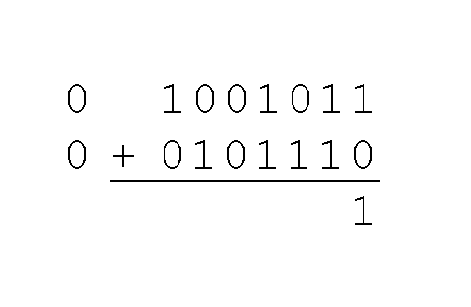
2.4 Signed Integer Representation
Example:
  Using signed magnitude binary arithmetic, find the sum of 75 and 46.
Just as in decimal arithmetic, we find the sum starting with the rightmost bit and work left.

Slide 21
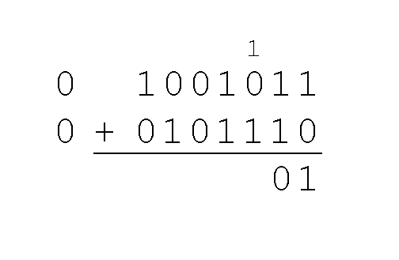
2.4 Signed Integer Representation
Example:
  Using signed magnitude binary arithmetic, find the sum of 75 and 46.
In the second bit, we have a carry, so we note it above the third bit.

Slide 22
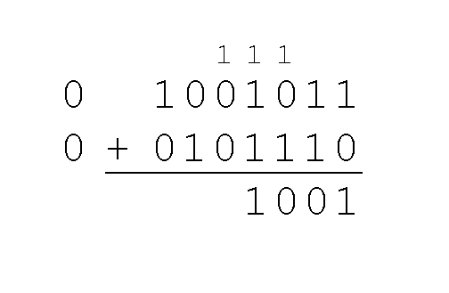
2.4 Signed Integer Representation
Example:
  Using signed magnitude binary arithmetic, find the sum of 75 and 46.
The third and fourth bits also give us carries.

Slide 23
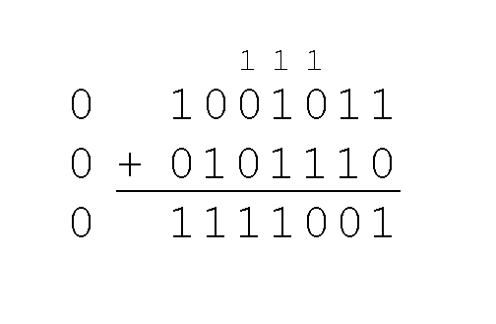
2.4 Signed Integer Representation
Example:
  Using signed magnitude binary arithmetic, find the sum of 75 and 46.
Once we have worked our way through all eight bits, we are done.
In this example, we were careful careful to pick two values whose sum would fit into seven bits. If that is not the case, we have a problem.

Slide 24
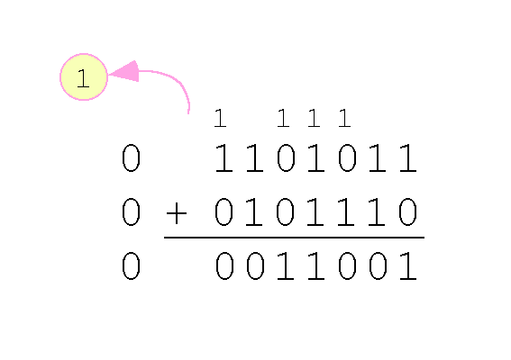
2.4 Signed Integer Representation
Example:
  Using signed magnitude binary arithmetic, find the sum of 107 and 46.
We see that the carry from the seventh bit overflows and is discarded, giving us the erroneous result: 107 + 46 = 25.

Slide 25
2.4 Signed Integer Representation
Signed magnitude representation is easy for people to understand, but it requires complicated computer hardware.
Another disadvantage of signed magnitude is that it allows two different representations for zero: positive zero and negative zero.
For these reasons (among others) computers systems employ complement systems for numeric value representation.

Slide 26
2.4 Signed Integer Representation
In diminished radix complement systems, a negative value is given by the difference between the absolute value of a number and one less than its base.
In the binary system, this gives us one’s complement. It amounts to little more than flipping the bits of a binary number.

Slide 27
2.4 Signed Integer Representation
For example, in 8-bit one’s complement, positive 3 is: 00000011
Negative 3 is: 11111100
In one’s complement, as with signed magnitude, negative values are indicated by a 1 in the high order bit.
Complement systems are useful because they eliminate the need for subtraction. The difference of two values is found by adding the minuend to the complement of the subtrahend.

Slide 28
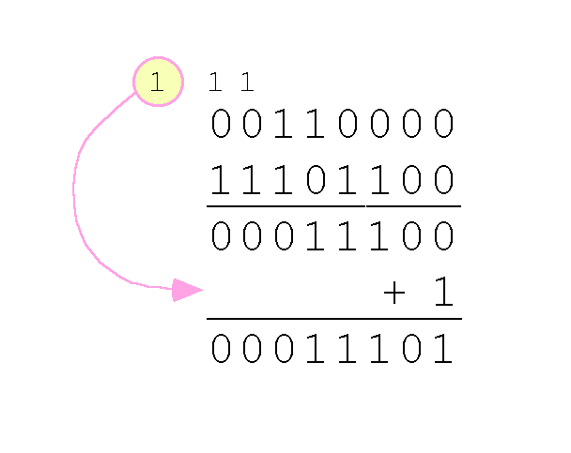
2.4 Signed Integer Representation
With one’s complement addition, the carry bit is “carried around” and added to the sum.
  Example: Using one’s complement binary arithmetic, find the sum of 48 and - 19
  We note that 19 in one’s complement is 00010011, so -19 in one’s complement is: 11101100.

Slide 29
2.4 Signed Integer Representation
Although the “end carry around” adds some complexity, one’s complement is simpler to implement than signed magnitude.
But it still has the disadvantage of having two different representations for zero: positive zero and negative zero.
Two’s complement solves this problem.It is the radix complement of the binary numbering system.

Slide 30
2.4 Signed Integer Representation
To express a value in two’s complement:
  If the number is positive, just convert it to binary and you’re done.
  If the number is negative, find the one’s complement of the number and then add 1.
Example:
  In 8-bit one’s complement, positive 3 is: 00000011
  Negative 3 in one’s complement is: 11111100
  Adding 1 gives us -3 in two’s complement form: 11111101.

Slide 31
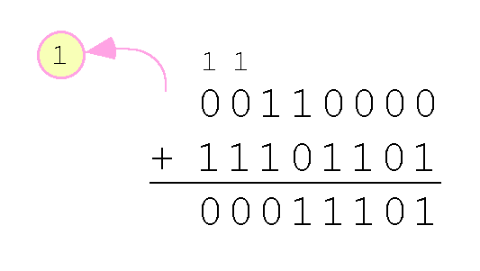
2.4 Signed Integer Representation
With two’s complement arithmetic, all we do is add our two binary numbers. Just discard any carries emitting from the high order bit.
Example: Using one’s complement binary arithmetic, find the sum of 48 and - 19.
  We note that 19 in one’s complement is: 00010011, so -19 in one’s complement is: 11101100,
  and -19 in two’s complement is: 11101101.

Slide 32
2.4 Signed Integer Representation
When we use any finite number of bits to represent a number, we always run the risk of the result of our calculations becoming too large to be stored in the computer.
While we can’t always prevent overflow, we can always detect overflow.
In complement arithmetic, an overflow condition is easy to detect.

Slide 33
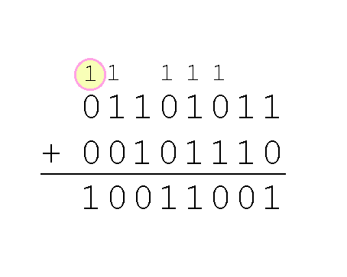
2.4 Signed Integer Representation
Example:
  Using two’s complement binary arithmetic, find the sum of 107 and 46.
We see that the nonzero carry from the seventh bit overflows into the sign bit, giving us the erroneous result: 107 + 46 = -103.
Rule for detecting signed two’s complement overflow: When the “carry in” and the “carry out” of the sign bit differ, overflow has occurred.

Slide 34
2.4 Signed Integer Representation
Signed and unsigned numbers are both useful.
  For example, memory addresses are always unsigned.
Using the same number of bits, unsigned integers can express twice as many values as signed numbers.
Trouble arises if an unsigned value “wraps around.”
  In four bits: 1111 + 1 = 0000.
Good programmers stay alert for this kind of problem.

Slide 35
2.4 Signed Integer Multiplication
Research into finding better arithmetic algorithms has continued apace for over 50 years.
One of the many interesting products of this work is Booth’s algorithm.
In most cases, Booth’s algorithm carries out multiplication faster and more accurately than naïve pencil-and-paper methods.
The general idea is to replace arithmetic operations with bit shifting to the extent possible.

Slide 36
2.4 Signed Integer Multiplication
⁰⁰¹¹
^{x 0110}
⁺ ⁰⁰⁰⁰
⁻ ⁰⁰¹¹
⁺ ⁰⁰⁰⁰
^{+ 0011____}
⁰⁰⁰¹⁰⁰¹⁰
In Booth’s algorithm, the first 1 in a string of 1s in the multiplier is replaced with a subtraction of the multiplicand.
Shift the partial sums until the last 1 of the string is detected.
Then add the multiplicand.

Slide 37
2.4 Signed Integer Multiplication
⁰⁰¹¹⁰¹⁰¹
^{x 01111110}
⁺ ⁰⁰⁰⁰⁰⁰⁰⁰⁰⁰⁰⁰⁰⁰⁰⁰
^{+ 111111111001011 (?)}
⁺ ⁰⁰⁰⁰⁰⁰⁰⁰⁰⁰⁰⁰⁰⁰
⁺ ⁰⁰⁰⁰⁰⁰⁰⁰⁰⁰⁰⁰⁰
⁺ ⁰⁰⁰⁰⁰⁰⁰⁰⁰⁰⁰⁰
⁺ ⁰⁰⁰⁰⁰⁰⁰⁰⁰⁰⁰
⁺ ⁰⁰⁰⁰⁰⁰⁰⁰⁰⁰
^{+ 000110101_______}
¹⁰⁰⁰¹¹⁰¹⁰⁰⁰⁰¹⁰¹¹⁰
Here is a larger example.
Ignore all bits over 2n.

Slide 38
2.4 Signed Integer Representation
Overflow and carry are tricky ideas.
Signed number overflow means nothing in the context of unsigned numbers, which set a carry flag instead of an overflow flag.
If a carry out of the leftmost bit occurs with an unsigned number, overflow has occurred.
Carry and overflow occur independently of each other.
The table on the next slide summarizes these ideas.

Slide 39
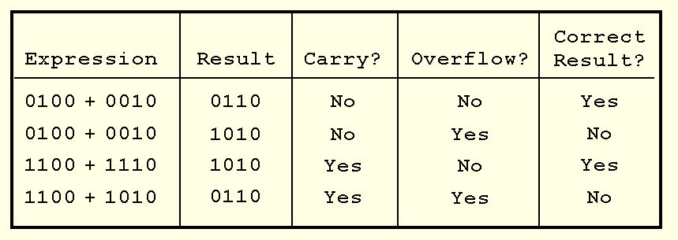
2.4 Signed Integer Representation

Slide 40
2.5 Floating-Point Representation
The signed magnitude, 1’s complement, and 2’s complement representations as such are not useful in scientific or business applications that deal with real number values over a wide range.
Floating-point representation solves this problem.

Slide 41
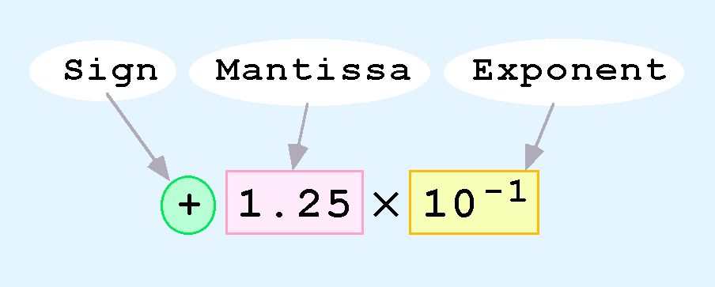
2.5 Floating-Point Representation
Computers use a form of scientific notation for floating-point representation
Numbers written in scientific notation have three components:

Slide 42
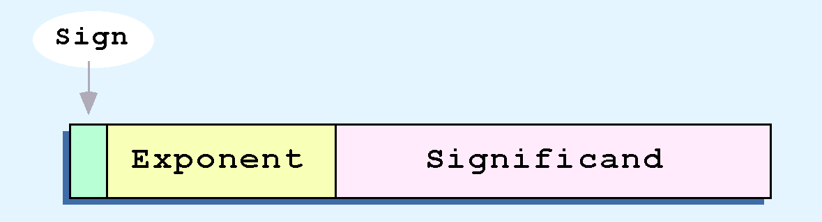
2.5 Floating-Point Representation
Computer representation of a floating-point number consists of three fixed-size fields:
This is the standard arrangement of these fields.

Slide 43
2.5 Floating-Point Representation
The one-bit sign field is the sign of the stored value.
The size of the exponent field, determines the range of values that can be represented.
The size of the significand determines the precision of the representation.

Slide 44
2.5 Floating-Point Representation
The IEEE-754 single precision floating point standard uses an 8-bit exponent and a 23-bit significand.
The IEEE-754 double precision standard uses an 11-bit exponent and a 52-bit significand.
For illustrative purposes, we will use a 14-bit model with a 5-bit exponent and an 8-bit significand.

Slide 45
2.5 Floating-Point Representation
The significand of a floating-point number is always preceded by an implied binary point.
Thus, the significand always contains a fractional binary value.
The exponent indicates the power of 2 to which the significand is raised.

Slide 46
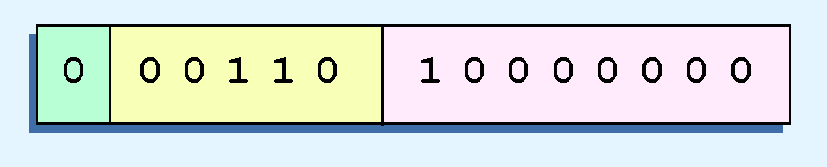
2.5 Floating-Point Representation
Example:
  Express 32₁₀ in the simplified 14-bit floating-point model.
We know that 32 is 2⁵. So in (binary) scientific notation 32 = 1.0 x 2⁵ = 0.1 x 2⁶.
Using this information, we put 110 (= 6₁₀) in the exponent field and 1 in the significand as shown.

Slide 47
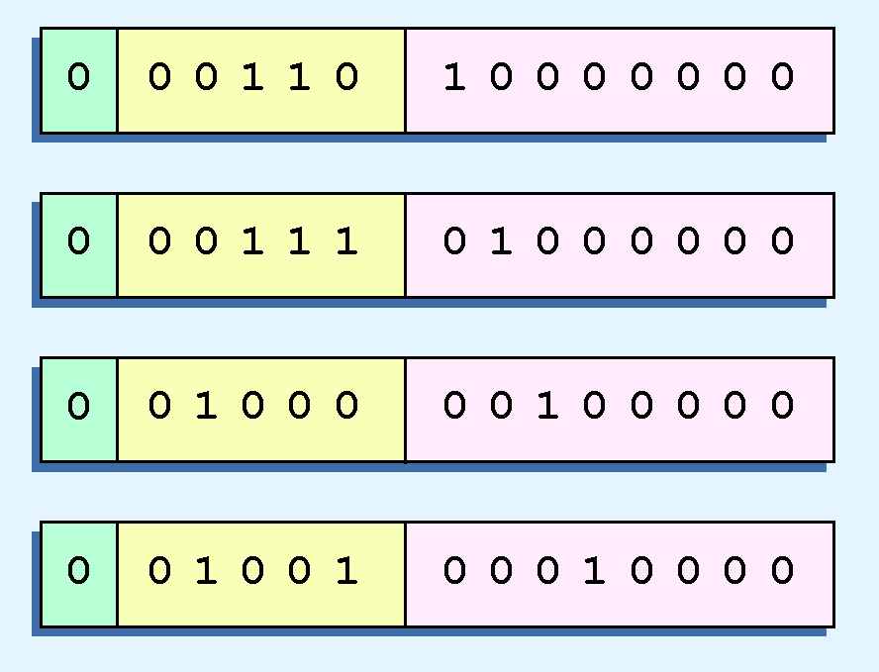
2.5 Floating-Point Representation
The illustrations shown at the right are all equivalent representations for 32 using our simplified model.
Not only do these synonymous representations waste space, but they can also cause confusion.

Slide 48
2.5 Floating-Point Representation
Another problem with our system is that we have made no allowances for negative exponents. We have no way to express 0.5 (=2 ⁻¹)! (Notice that there is no sign in the exponent field!)
All of these problems can be fixed with no changes to our basic model.

Slide 49
2.5 Floating-Point Representation
To resolve the problem of synonymous forms, we will establish a rule that the first digit of the significand must be 1. This results in a unique pattern for each floating-point number.
  In the IEEE-754 standard, this 1 is implied meaning that a 1 is assumed after the binary point.
  By using an implied 1, we increase the precision of the representation by a power of two. (Why?)
In our simple instructional model, we will use no implied bits.

Slide 50
2.5 Floating-Point Representation
To provide for negative exponents, we will use a biased exponent.
A bias is a number that is approximately midway in the range of values expressible by the exponent. We subtract the bias from the value in the exponent to determine its true value.
  In our case, we have a 5-bit exponent. We will use 16 for our bias. This is called excess-16 representation.
In our model, exponent values less than 16 are negative, representing fractional numbers.

Slide 51
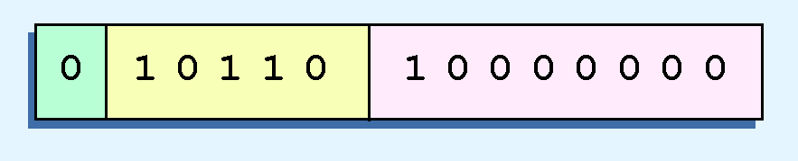
2.5 Floating-Point Representation
Example:
  Express 32₁₀ in the revised 14-bit floating-point model.
We know that 32 = 1.0 x 2⁵ = 0.1 x 2⁶.
To use our excess 16 biased exponent, we add 16 to 6, giving 22₁₀ (=10110₂).
Graphically:

Slide 52

2.5 Floating-Point Representation
Example:
  Express 0.0625₁₀ in the revised 14-bit floating-point model.
We know that 0.0625 is 2⁻⁴. So in (binary) scientific notation 0.0625 = 1.0 x 2⁻⁴ = 0.1 x 2 ⁻³.
To use our excess 16 biased exponent, we add 16 to -3, giving 13₁₀ (=01101₂).

Slide 53

2.5 Floating-Point Representation
Example:
  Express -26.625₁₀ in the revised 14-bit floating-point model.
We find 26.625₁₀ = 11010.101₂. Normalizing, we have: 26.625₁₀ = 0.11010101 x 2 ⁵.
To use our excess 16 biased exponent, we add 16 to 5, giving 21₁₀ (=10101₂). We also need a 1 in the sign bit.

Slide 54
2.5 Floating-Point Representation
The IEEE-754 single precision floating point standard uses bias of 127 over its 8-bit exponent.
  An exponent of 255 indicates a special value.
    If the significand is zero, the value is ± infinity.
    If the significand is nonzero, the value is NaN, “not a number,” often used to flag an error condition.
The double precision standard has a bias of 1023 over its 11-bit exponent.
  The “special” exponent value for a double precision number is 2047, instead of the 255 used by the single precision standard.

Slide 55
2.5 Floating-Point Representation
Both the 14-bit model that we have presented and the IEEE-754 floating point standard allow two representations for zero.
  Zero is indicated by all zeros in the exponent and the significand, but the sign bit can be either 0 or 1.
This is why programmers should avoid testing a floating-point value for equality to zero.
  Negative zero does not equal positive zero.

Slide 56
2.5 Floating-Point Representation
Floating-point addition and subtraction are done using methods analogous to how we perform calculations using pencil and paper.
The first thing that we do is express both operands in the same exponential power, then add the numbers, preserving the exponent in the sum.
If the exponent requires adjustment, we do so at the end of the calculation.

Slide 57
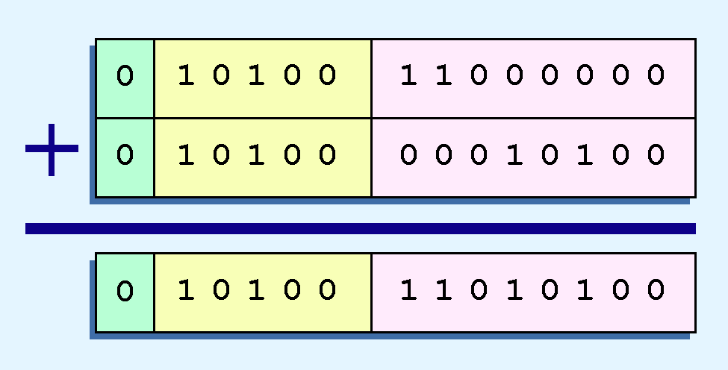
2.5 Floating-Point Representation
Example:
  Find the sum of 12₁₀ and 1.25₁₀ using the 14-bit floating-point model.
We find 12₁₀ = 0.1100 x 2 ⁴. And 1.25₁₀ = 0.101 x 2 ¹ = 0.000101 x 2 ⁴.
Thus, our sum is 0.110101 x 2 ⁴.

Slide 58
2.5 Floating-Point Representation
Floating-point multiplication is also carried out in a manner akin to how we perform multiplication using pencil and paper.
We multiply the two operands and add their exponents.
If the exponent requires adjustment, we do so at the end of the calculation.

Slide 59
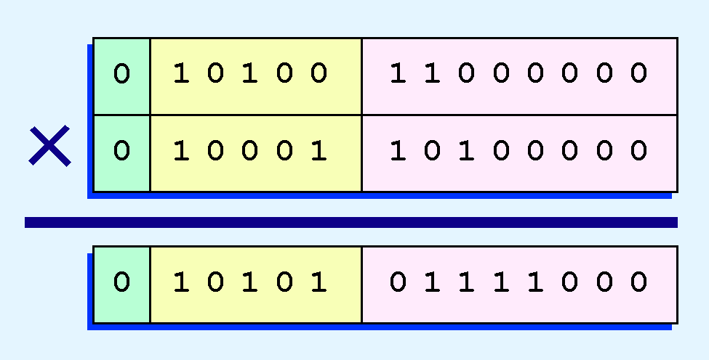
2.5 Floating-Point Representation
Example:
  Find the product of 12₁₀ and 1.25₁₀ using the 14-bit floating-point model.
We find 12₁₀ = 0.1100 x 2 ⁴. And 1.25₁₀ = 0.101 x 2 ¹.
Thus, our product is 0.0111100 x 2 ⁵ ⁼ 0.1111 x 2 ⁴.
The normalized product requires an exponent of 22₁₀ = 10110₂.

Slide 60
2.5 Floating-Point Representation
No matter how many bits we use in a floating-point representation, our model must be finite.
The real number system is, of course, infinite, so our models can give nothing more than an approximation of a real value.
At some point, every model breaks down, introducing errors into our calculations.
By using a greater number of bits in our model, we can reduce these errors, but we can never totally eliminate them.

Slide 61
2.5 Floating-Point Representation
Our job becomes one of reducing error, or at least being aware of the possible magnitude of error in our calculations.
We must also be aware that errors can compound through repetitive arithmetic operations.
For example, our 14-bit model cannot exactly represent the decimal value 128.5. In binary, it is 9 bits wide:
  10000000.1₂ = 128.5₁₀

Slide 62
2.5 Floating-Point Representation
When we try to express 128.5₁₀ in our 14-bit model, we lose the low-order bit, giving a relative error of:
If we had a procedure that repetitively added 0.5 to 128.5, we would have an error of nearly 2% after only four iterations.
^{128.5 - 128}
^{128.5}
^{≈ 0.39%}

Slide 63
2.5 Floating-Point Representation
Floating-point errors can be reduced when we use operands that are similar in magnitude.
If we were repetitively adding 0.5 to 128.5, it would have been better to iteratively add 0.5 to itself and then add 128.5 to this sum.
In this example, the error was caused by loss of the low-order bit.
Loss of the high-order bit is more problematic.

Slide 64
2.5 Floating-Point Representation
Floating-point overflow and underflow can cause programs to crash.
Overflow occurs when there is no room to store the high-order bits resulting from a calculation.
Underflow occurs when a value is too small to store, possibly resulting in division by zero.
Experienced programmers know that it’s better for a program to crash than to have it produce incorrect, but plausible, results.

Slide 65
2.5 Floating-Point Representation
When discussing floating-point numbers, it is important to understand the terms range, precision, and accuracy.
The range of a numeric integer format is the difference between the largest and smallest values that is can express.
Accuracy refers to how closely a numeric representation approximates a true value.
The precision of a number indicates how much information we have about a value

Slide 66
2.5 Floating-Point Representation
Most of the time, greater precision leads to better accuracy, but this is not always true.
  For example, 3.1333 is a value of pi that is accurate to two digits, but has 5 digits of precision.
There are other problems with floating point numbers.
Because of truncated bits, you cannot always assume that a particular floating point operation is commutative or distributive.

Slide 67
2.5 Floating-Point Representation
This means that we cannot assume:
    (a + b) + c = a + (b + c) or
    a*(b + c) = ab + ac
Moreover, to test a floating point value for equality to some other number, first figure out how close one number can be to be considered equal. Call this value epsilon and use the statement:
    if (abs(x) < epsilon) then ...

Slide 68
2.6 Character Codes
Calculations aren’t useful until their results can be displayed in a manner that is meaningful to people.
We also need to store the results of calculations, and provide a means for data input.
Thus, human-understandable characters must be converted to computer-understandable bit patterns using some sort of character encoding scheme.

Slide 69
2.6 Character Codes
As computers have evolved, character codes have evolved.
Larger computer memories and storage devices permit richer character codes.
The earliest computer coding systems used six bits.
Binary-coded decimal (BCD) was one of these early codes. It was used by IBM mainframes in the 1950s and 1960s.

Slide 70
2.6 Character Codes
In 1964, BCD was extended to an 8-bit code, Extended Binary-Coded Decimal Interchange Code (EBCDIC).
EBCDIC was one of the first widely-used computer codes that supported upper and lowercase alphabetic characters, in addition to special characters, such as punctuation and control characters.
EBCDIC and BCD are still in use by IBM mainframes today.

Slide 71
2.6 Character Codes
Other computer manufacturers chose the 7-bit ASCII (American Standard Code for Information Interchange) as a replacement for 6-bit codes.
While BCD and EBCDIC were based upon punched card codes, ASCII was based upon telecommunications (Telex) codes.
Until recently, ASCII was the dominant character code outside the IBM mainframe world.

Slide 72
2.6 Character Codes
Many of today’s systems embrace Unicode, a 16-bit system that can encode the characters of every language in the world.
  The Java programming language, and some operating systems now use Unicode as their default character code.
The Unicode codespace is divided into six parts. The first part is for Western alphabet codes, including English, Greek, and Russian.

Slide 73
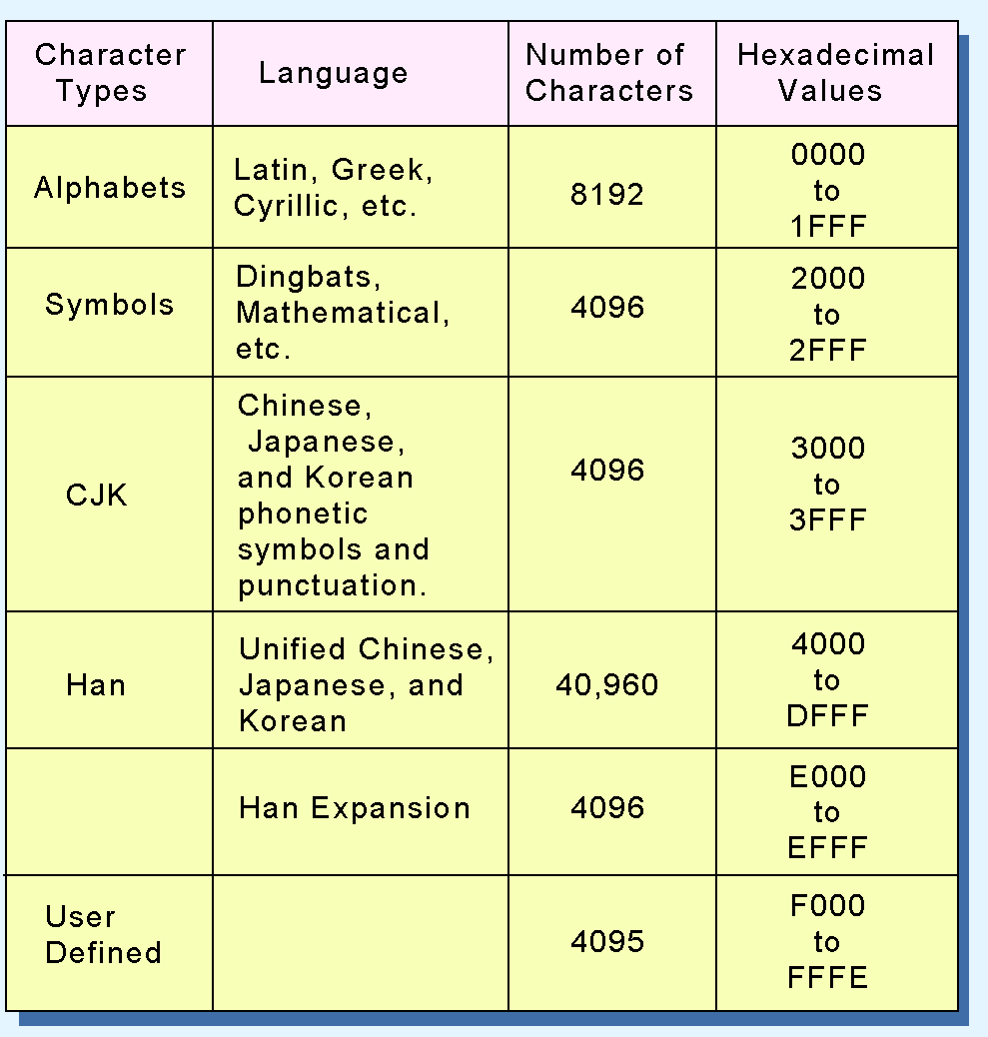
2.6 Character Codes
The Unicode codes- pace allocation is shown at the right.
The lowest-numbered Unicode characters comprise the ASCII code.
The highest provide for user-defined codes.

Slide 74
2.8 Error Detection and Correction
It is physically impossible for any data recording or transmission medium to be 100% perfect 100% of the time over its entire expected useful life.
As more bits are packed onto a square centimeter of disk storage, as communications transmission speeds increase, the likelihood of error increases-- sometimes geometrically.
Thus, error detection and correction is critical to accurate data transmission, storage and retrieval.

Slide 75
2.8 Error Detection and Correction
Check digits, appended to the end of a long number can provide some protection against data input errors.
  The last character of UPC barcodes and ISBNs are check digits.
Longer data streams require more economical and sophisticated error detection mechanisms.
Cyclic redundancy checking (CRC) codes provide error detection for large blocks of data.

Slide 76
2.8 Error Detection and Correction
Checksums and CRCs are examples of systematic error detection.
In systematic error detection a group of error control bits is appended to the end of the block of transmitted data.
  This group of bits is called a syndrome.
CRCs are polynomials over the modulo 2 arithmetic field.
The mathematical theory behind modulo 2 polynomials is beyond our scope. However, we can easily work with it without knowing its theoretical underpinnings.

Slide 77
2.8 Error Detection and Correction
Modulo 2 arithmetic works like clock arithmetic.
In clock arithmetic, if we add 2 hours to 11:00, we get 1:00.
In modulo 2 arithmetic if we add 1 to 1, we get 0. The addition rules couldn’t be simpler:
⁰ ⁺ ⁰ ⁼ ⁰ ⁰ ⁺ ¹ ⁼ ¹
¹ ⁺ ⁰ ⁼ ¹ ¹ ⁺ ¹ ⁼ ⁰
You will fully understand why modulo 2 arithmetic is so handy after you study digital circuits in Chapter 3.

Slide 78
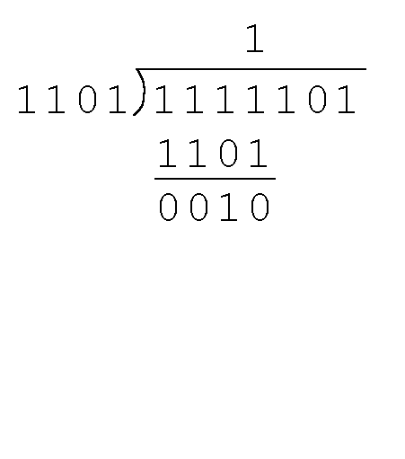
2.8 Error Detection and Correction
Find the quotient and remainder when 1111101 is divided by 1101 in modulo 2 arithmetic.
  As with traditional division, we note that the dividend is divisible once by the divisor.
  We place the divisor under the dividend and perform modulo 2 subtraction.

Slide 79
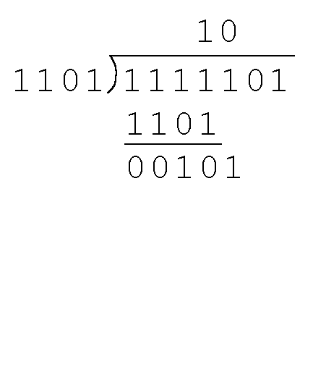
2.8 Error Detection and Correction
Find the quotient and remainder when 1111101 is divided by 1101 in modulo 2 arithmetic…
  Now we bring down the next bit of the dividend.
  We see that 00101 is not divisible by 1101. So we place a zero in the quotient.

Slide 80
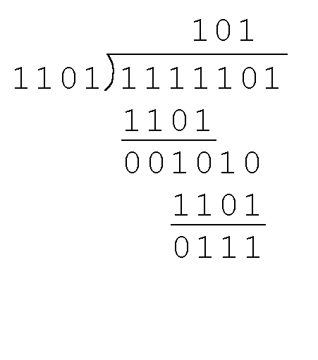
2.8 Error Detection and Correction
Find the quotient and remainder when 1111101 is divided by 1101 in modulo 2 arithmetic…
  1010 is divisible by 1101 in modulo 2.
  We perform the modulo 2 subtraction.

Slide 81
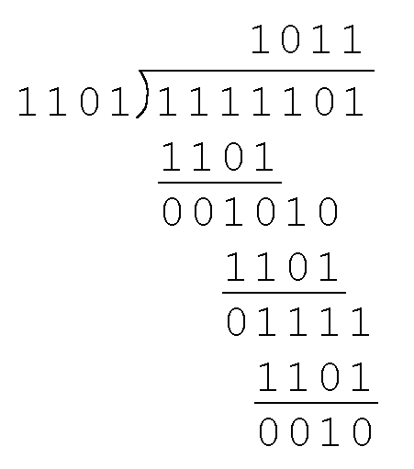
2.8 Error Detection and Correction
Find the quotient and remainder when 1111101 is divided by 1101 in modulo 2 arithmetic…
  We find the quotient is 1011, and the remainder is 0010.
This procedure is very useful to us in calculating CRC syndromes.
Note: The divisor in this example corresponds to a modulo 2 polynomial: X ³ + X ² + 1.

Slide 82
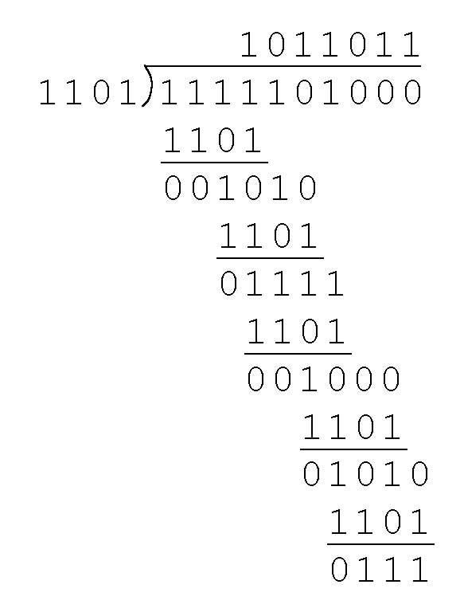
2.8 Error Detection and Correction
Suppose we want to transmit the information string: 1111101.
The receiver and sender decide to use the (arbitrary) polynomial pattern, 1101.
The information string is shifted left by one position less than the number of positions in the divisor.
The remainder is found through modulo 2 division (at right) and added to the information string: 1111101000 + 111 = 1111101111.

Slide 83
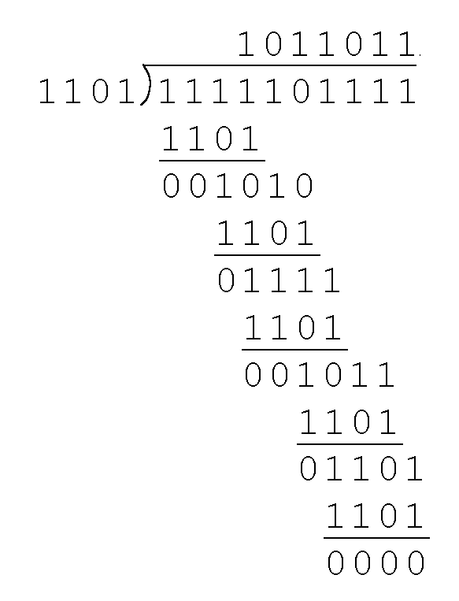
2.8 Error Detection and Correction
If no bits are lost or corrupted, dividing the received information string by the agreed upon pattern will give a remainder of zero.
We see this is so in the calculation at the right.
Real applications use longer polynomials to cover larger information strings.
  Some of the standard poly-nomials are listed in the text.

Slide 84
2.8 Error Detection and Correction
Data transmission errors are easy to fix once an error is detected.
  Just ask the sender to transmit the data again.
In computer memory and data storage, however, this cannot be done.
  Too often the only copy of something important is in memory or on disk.
Thus, to provide data integrity over the long term, error correcting codes are required.

Slide 85
2.8 Error Detection and Correction
Hamming codes and Reed-Soloman codes are two important error correcting codes.
Reed-Soloman codes are particularly useful in correcting burst errors that occur when a series of adjacent bits are damaged.
  Because CD-ROMs are easily scratched, they employ a type of Reed-Soloman error correction.
Because the mathematics of Hamming codes is much simpler than Reed-Soloman, we discuss Hamming codes in detail.

Slide 86
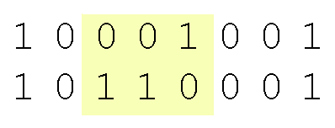
2.8 Error Detection and Correction
Hamming codes are code words formed by adding redundant check bits, or parity bits, to a data word.
The Hamming distance between two code words is the number of bits in which two code words differ.
The minimum Hamming distance for a code is the smallest Hamming distance between all pairs of words in the code.
This pair of bytes has a Hamming distance of 3:

Slide 87
2.8 Error Detection and Correction
The minimum Hamming distance for a code, D(min), determines its error detecting and error correcting capability.
For any code word, X, to be interpreted as a different valid code word, Y, at least D(min) single-bit errors must occur in X.
Thus, to detect k (or fewer) single-bit errors, the code must have a Hamming distance of D(min) = k + 1.

Slide 88
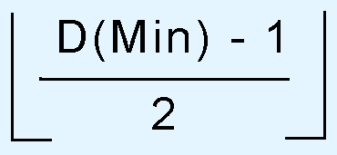
2.8 Error Detection and Correction
Hamming codes can detect D(min) - 1 errors and correct errors
Thus, a Hamming distance of 2k + 1 is required to be able to correct k errors in any data word.
Hamming distance is provided by adding a suitable number of parity bits to a data word.

Slide 89
2.8 Error Detection and Correction
Suppose we have a set of n-bit code words consisting of m data bits and r (redundant) parity bits.
An error could occur in any of the n bits, so each code word can be associated with n erroneous words at a Hamming distance of 1.
Therefore,we have n + 1 bit patterns for each code word: one valid code word, and n erroneous words.

Slide 90
2.8 Error Detection and Correction
With n-bit code words, we have 2 ^{n} possible code words consisting of 2 ^{m} data bits (where n = m + r).
This gives us the inequality:
(n + 1) × 2 ^{m} ≤ 2 ^{n}
Because n = m + r, we can rewrite the inequality as:
(m + r + 1) × 2 ^{m} ≤ 2 ^{m + r} or (m + r + 1) ≤ 2 ^{r}
  This inequality gives us a lower limit on the number of check bits that we need in our code words.

Slide 91
2.8 Error Detection and Correction
Suppose we have data words of length m = 4. Then:
(4 + r + 1) ≤ 2 ^{r}
implies that r must be greater than or equal to 3.
This means to build a code with 4-bit data words that will correct single-bit errors, we must add 3 check bits.
Finding the number of check bits is the hard part. The rest is easy.

Slide 92
2.8 Error Detection and Correction
Suppose we have data words of length m = 8. Then:
(8 + r + 1) ≤ 2 ^{r}
implies that r must be greater than or equal to 4.
This means to build a code with 8-bit data words that will correct single-bit errors, we must add 4 check bits, creating code words of length 12.
So how do we assign values to these check bits?

Slide 93
2.8 Error Detection and Correction
With code words of length 12, we observe that each of the digits, 1 though 12, can be expressed in powers of 2. Thus:
1 = 2 ⁰ 5 = 2 ² + 2 ⁰ 9 = 2 ³ + 2 ⁰
2 = 2 ¹ 6 = 2 ² + 2 ¹ 10 = 2 ³ + 2 ¹
3 = 2 ¹ + 2 ⁰ 7 = 2 ² + 2 ¹ + 2 ⁰ 11 = 2 ³ + 2 ¹ + 2 ⁰
4 = 2 ² 8 = 2 ³ 12 = 2 ³ + 2 ²
  1 (= 2⁰) contributes to all of the odd-numbered digits.
  2 (= 2¹) contributes to the digits, 2, 3, 6, 7, 10, and 11.
  . . . And so forth . . .
We can use this idea in the creation of our check bits.

Slide 94
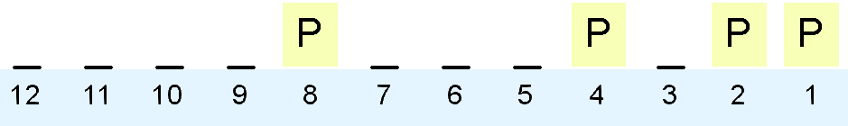
2.8 Error Detection and Correction
Using our code words of length 12, number each bit position starting with 1 in the low-order bit.
Each bit position corresponding to an even power of 2 will be occupied by a check bit.
These check bits contain the parity of each bit position for which it participates in the sum.

Slide 95
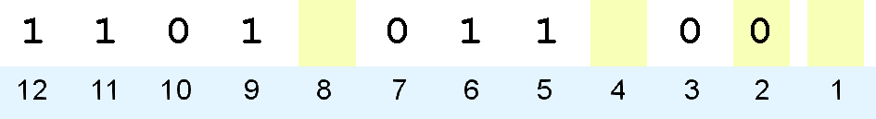
2.8 Error Detection and Correction
Since 2 (= 2¹) contributes to the digits, 2, 3, 6, 7, 10, and 11. Position 2 will contain the parity for bits 3, 6, 7, 10, and 11.
When we use even parity, this is the modulo 2 sum of the participating bit values.
For the bit values shown, we have a parity value of 0 in the second bit position.
What are the values for the other parity bits?

Slide 96
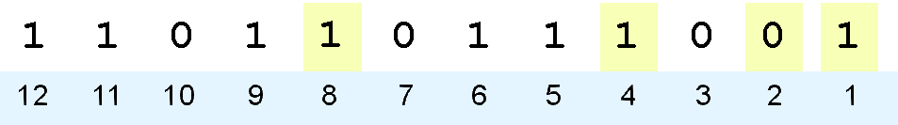
2.8 Error Detection and Correction
The completed code word is shown above.
  Bit 1checks the digits, 3, 5, 7, 9, and 11, so its value is 1.
  Bit 4 checks the digits, 5, 6, 7, and 12, so its value is 1.
  Bit 8 checks the digits, 9, 10, 11, and 12, so its value is also 1.
Using the Hamming algorithm, we can not only detect single bit errors in this code word, but also correct them!

Slide 97
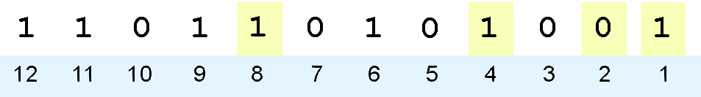
2.8 Error Detection and Correction
Suppose an error occurs in bit 5, as shown above. Our parity bit values are:
  Bit 1 checks digits, 3, 5, 7, 9, and 11. Its value is 1, but should be zero.
  Bit 2 checks digits 2, 3, 6, 7, 10, and 11. The zero is correct.
  Bit 4 checks digits, 5, 6, 7, and 12. Its value is 1, but should be zero.
  Bit 8 checks digits, 9, 10, 11, and 12. This bit is correct.

Slide 98
2.8 Error Detection and Correction
We have erroneous bits in positions 1 and 4.
With two parity bits that don’t check, we know that the error is in the data, and not in a parity bit.
Which data bits are in error? We find out by adding the bit positions of the erroneous bits.
Simply, 1 + 4 = 5. This tells us that the error is in bit 5. If we change bit 5 to a 1, all parity bits check and our data is restored.

Slide 99
Chapter 2 Conclusion
Computers store data in the form of bits, bytes, and words using the binary numbering system.
Hexadecimal numbers are formed using four-bit groups called nibbles (or nybbles).
Signed integers can be stored in one’s complement, two’s complement, or signed magnitude representation.
Floating-point numbers are usually coded using the IEEE 754 floating-point standard.

Slide 100
Chapter 2 Conclusion
Floating-point operations are not necessarily commutative or distributive.
Character data is stored using ASCII, EBCDIC, or Unicode.
Error detecting and correcting codes are necessary because we can expect no transmission or storage medium to be perfect.
CRC, Reed-Soloman, and Hamming codes are three important error control codes.

Slide 101
End of Chapter 2

